Slide 1
FastAPI Python Library for Model Deployment
Building production-ready APIs for machine learning and data science applications — from core concepts to a live
stock analytics project.

Slide 2
Contents
01
02
03
Understanding APIs
Introduction to FastAPI
FastAPI in Data Science
What APIs are, how they work, and why they matter for data science systems.
Core capabilities, design philosophy, and what makes FastAPI stand out.
Real-world use cases across model deployment, automation, and dashboards.
04
05
Building a Real-World Project
End-to-End System Design
Step-by-step construction of a live stock analytics API
from scratch.
Connecting frontend, backend, data logic, and cloud deployment into one complete system.

Slide 3
What is an API?
API = Application Programming Interface. A set of rules, protocols, and tools that define how software components interact, communicate, and exchange data with each other. APIs are the backbone of modern software systems — enabling interoperability across platforms, languages, and environments.
Request-Response Cycle
HTTP Methods
Standardized Communication
A client sends a request with parameters and authentication. The server processes it, executes business logic, and returns structured JSON or XML.
GET retrieves data · POST creates data · PUT updates data · DELETE removes data. Each method communicates intent clearly to the server.
APIs provide a universal language for applications to talk to each other — across platforms, programming languages, and cloud environments.

Slide 4

What is FastAPI?
A modern, high-performance Python web framework designed for building APIs with automatic validation, serialization, and interactive documentation — with minimal code and maximum performance.
In simple words: FastAPI turns your Python functions — ML predictions, database queries, business logic — into web services that any application can call over the internet. Write a Python function, add a decorator, and it becomes a live API endpoint.
Built on Modern Standards
Async-First Design
Minimal Boilerplate
FastAPI is built on top of Starlette for the web layer and Pydantic for data validation — both battle-tested and production-proven libraries.
Native support for Python's async and await syntax enables non-blocking I/O — critical for high-throughput ML inference services.
What would take hundreds of lines in Flask or Django can be expressed in tens of lines with FastAPI — without sacrificing robustness or correctness.

Slide 5
Why Choose FastAPI?
Blazing Fast Performance
Automatic Documentation
Execution speed comparable to Node.js and Go, powered by async support, efficient routing, and ASGI server compatibility. One of the fastest Python frameworks available today.
Swagger UI and ReDoc generated automatically from your code annotations and type hints — no extra setup required. Your API is self-documenting from day one.
Type Safety & Validation
ML Integration
Built-in data validation using Python type hints and Pydantic models, catching errors before they reach business logic. Invalid requests are rejected automatically with clear error messages.
Seamless compatibility with scikit-learn, TensorFlow, pandas, and other major ML and data science libraries. Deploy any trained model as a REST endpoint in minutes.

Slide 6

How FastAPI Processes a Request
Client Request
Business Logic
HTTP call with headers and params
Model prediction, DB query, calculation
Request Routing
Response Delivery
Matched to Python function via decorators
Serialized JSON sent back to client
Every request follows this predictable lifecycle — making FastAPI-based systems transparent, debuggable, and easy to scale in production environments.

Slide 7
Where is FastAPI Used in Data Science?
FastAPI has become the go-to framework for productionizing data science work across a wide range of applications. Here are the most common use cases:
Model Deployment
Data Automation
Deploying ML prediction models as production-ready REST APIs for real-time inference, batch processing, and A/B testing of model versions.
Automating ETL pipelines, scheduled analytics workflows, and data quality monitoring systems that run reliably without manual intervention.
Dashboard Backends
Frontend Integration
Serving interactive dashboards and data visualizations with real-time updates, feeding tools like Streamlit, Dash, or custom React frontends.
Connecting ML models with web and mobile apps through standardized APIs, enabling seamless and responsive user experiences at scale.

Slide 8




CASE STUDY
Stock Analytics API
A real-world case study demonstrating FastAPI's full capabilities — from data ingestion and metric calculation to frontend integration and cloud deployment.
Step 1 & 2: Data Preparation
Step 3: API Development
Step 4: Frontend Integration
Collect 1 year of historical stock data and compute key financial metrics using yfinance and pandas. Returns, volatility, min/max, current prices via pandas for rolling one year window.
Wrap Python logic in FastAPI route decorators to convert it into a callable HTTP endpoint.
Connect an HTML + JavaScript page to fetch and display live stock data in a browser table.
Final Outcome: A complete system where users can fetch live stock insights through a web interface — fully automated, no manual scripts needed.

Slide 9
Steps 1 & 2: Data Preparation & Metric Calculation
def generate_us_stock_summary():
end_date = datetime.now().date()
start_date = end_date - timedelta(days=365)
symbols = [
"NVDA", "GOOGL", "AAPL", "MSFT", "AMZN",
"META", "AVGO", "TSLA", "ORCL", "PLTR"
]
stockdata = yf.download(
tickers=symbols,
start=start_date,
end=end_date,
progress=False
)
closeprice_df = stockdata["Close"].copy()
returns_df = closeprice_df.pct_change() * 100
summary_df = pd.DataFrame({
"Ticker": closeprice_df.columns,
"Max_Value": closeprice_df.max().values,
"Min_Value": closeprice_df.min().values,
"Current_Value": closeprice_df.iloc[-1].values,
"Avg_Daily_Return_%": returns_df.mean().values,
"Volatility_%": returns_df.std().values
})
return summary_df
Selected Tickers
NVDA · GOOGL · AAPL · MSFT · AMZN · META · AVGO · TSLA · ORCL · PLTR
Source: yfinance — 1 year of historical daily close prices.
Metrics Calculated
Minimum price over the period
Maximum price over the period
Current price (latest close)
Average daily return (%)
Volatility (standard deviation of returns)

Slide 10

Step 3: API Development using FastAPI
FastAPI wraps Python logic into accessible HTTP endpoints callable from any client — browser, mobile app, or another service. Below is the complete endpoint definition for the stock analytics API.
FastAPI Initialization Flow
from fastapi import FastAPI
app = FastAPI()
@app.get("/us-stocks")
def get_us_stock_summary():
result = generate_us_stock_summary()
return result.round(4).to_dict(
orient="records"
)
1
Create FastAPI app instance
2
Define route using @app.get decorator
3
Call the stock calculation function
4
Return results as formatted JSON
The @app.get decorator creates a GET endpoint any HTTP client can call to retrieve live stock data — fully validated and serialized automatically.

Slide 11
Step 4: Connecting Frontend to Backend API
The frontend is a lightweight HTML page with JavaScript that communicates with the FastAPI backend. No framework required — just standard browser APIs.
Open HTML Page
HTTP GET Request
UI Update
User opens the page in any browser
JavaScript calls the FastAPI endpoint
JavaScript renders data dynamically into a table
Click Button
JSON Response
Triggers "Load Stock Data" action
FastAPI processes and returns data
Live Deployment URL: https://us-stock-fastapi.onrender.com
JavaScript acts as a bridge between the HTML UI and the Python backend — no page reload required.

Slide 12
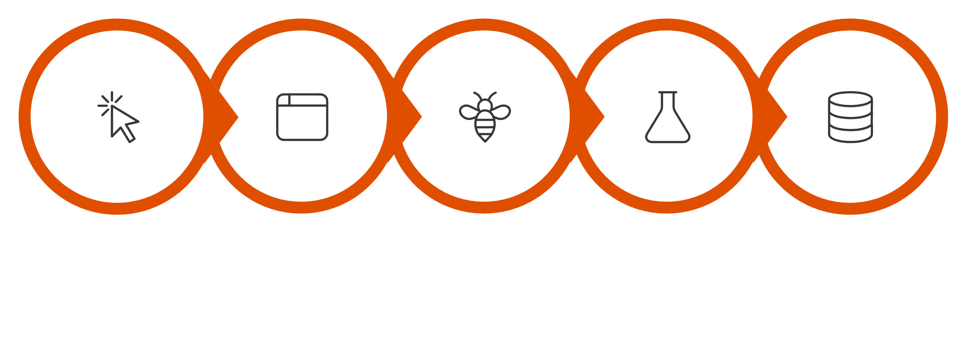
End-to-End Execution Flow
This is the complete request-to-response journey every time a user interacts with the application. Understanding this flow helps you debug issues, optimize latency, and extend the system.
Browser Request
FastAPI Handler
Python Processing
Fetch & Metrics
User Clicks
Frontend (HTML + JS) ↔ FastAPI ↔ Python Logic ↔ Data Source — each layer has a single, well-defined responsibility, making the system easy to maintain and extend.

Slide 13
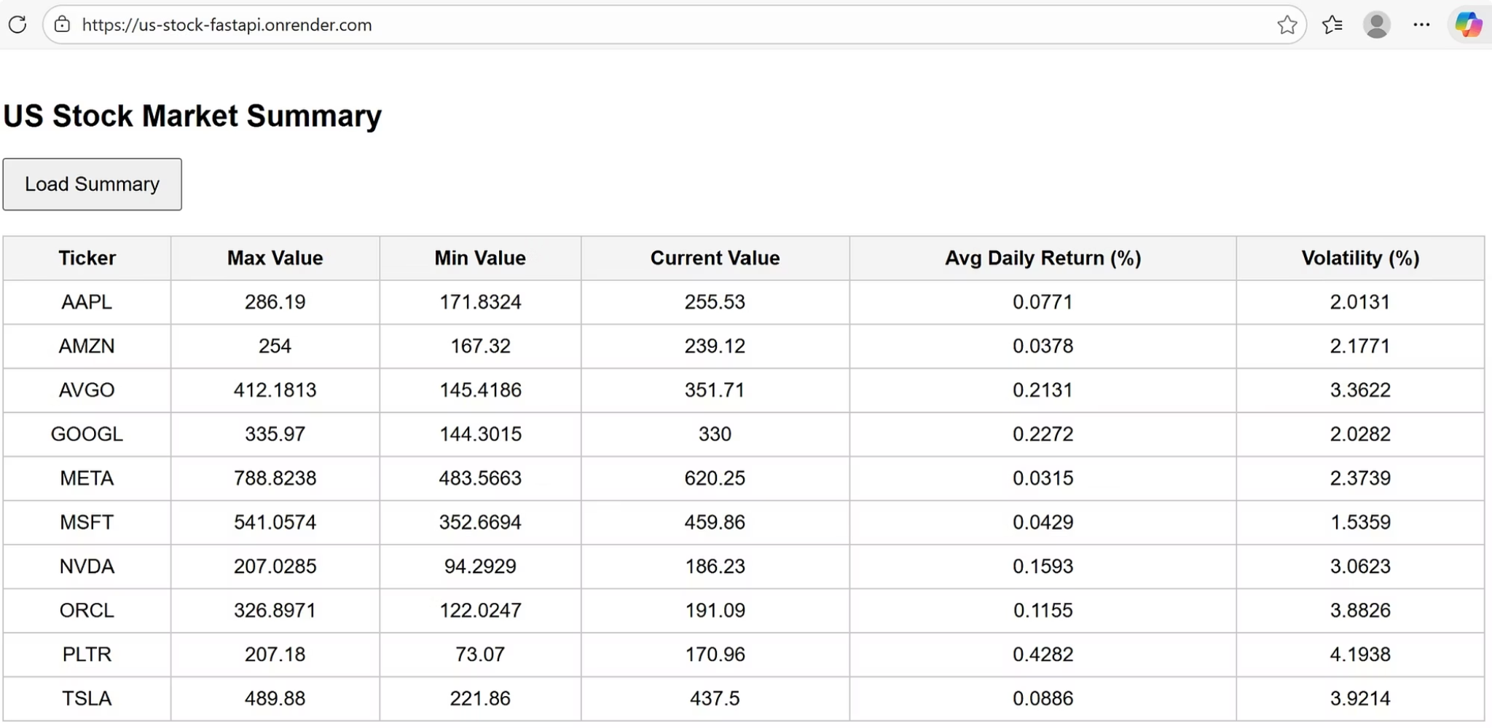

Live Output: Stock Data in the Browser
Clicking Load Summary triggers the full pipeline: Button → API Call → Python Processing → JSON → Table Rendered
This table is generated using HTML tags produced inside a FastAPI Python function and sent directly to the browser as a response — demonstrating how Python can control both data logic and presentation layer in a single endpoint.

Slide 14
Why Backend Automation Matters
Automating your data pipelines through FastAPI eliminates the friction between development and production — turning one-off scripts into reliable, always-available services.
Eliminate Manual Work
Consistency & Reliability
No need to manually run scripts, remember execution times, or perform repetitive data processing tasks every day. Automation frees analysts and engineers for higher-value work.
Standardized logic and validated code ensures error-free calculations every single time — eliminating human variability and reducing the risk of silent data errors.
Event-Driven Flexibility
Scalability
Schedule via cron jobs, trigger on specific events automatically, or call on-demand through any HTTP client. Your system adapts to any operational pattern.
Works equally well for real-time single-user applications and large-scale batch processing systems handling millions of records — with minimal code changes.

Slide 15


BUILD YOUR OWN
Steps to Build a Similar Project
Step 3: Build Frontend Connection
Step 2: Create API Endpoints
Step 1: Prepare Data & Logic
Wrap Python functions in FastAPI route decorators. Define input parameters and response models using Pydantic for automatic validation and clear API contracts.
Create an HTML page with JavaScript to call your API. Handle loading states and display results dynamically on the page without full page reloads.
Write and thoroughly test your Python data processing logic with sample datasets. Handle edge cases, nulls, and type errors before moving forward.
Pro Tip: Start with a single simple endpoint and gradually add complexity. Test each component independently before integration — this dramatically reduces debugging time.

Slide 16
Key Takeaways
FastAPI bridges the gap between data science experimentation and production-grade deployment — making it an essential tool in every ML engineer's stack.
APIs are Essential
Deployment is Key
APIs are foundational for building production-grade data science systems that integrate with any application, platform, or downstream consumer — internal or external.
Models and analytics only create real business value when deployed and accessible to end users in production. A model in a notebook is not a product.
FastAPI Simplifies Everything
End-to-End Integration
FastAPI makes deployment simple, scalable, and maintainable — with excellent performance, automatic docs, and an outstanding developer experience built in from the start.
A complete data pipeline from raw data to live user interface is achievable with minimal, clean Python code — no specialized infrastructure knowledge required.

